Slide 1
Convolutional Networks based Image Saliency Detection
By:
KAMAL SHARMA
(pre final year UG)
PARTH GOYAL
(pre final year UG)
Mentor : Dr. Ram Subramanian

Slide 2
Abstract
To predict salient features in an image, high-level visual features at multiple spatial scales must be extracted and augmented with relevant information.
To estimate the ﬁxation of the human eye across complex natural scenes.
Input: Image
Output: Visual Salient Image
More human attention –> More visual saliency

Slide 3
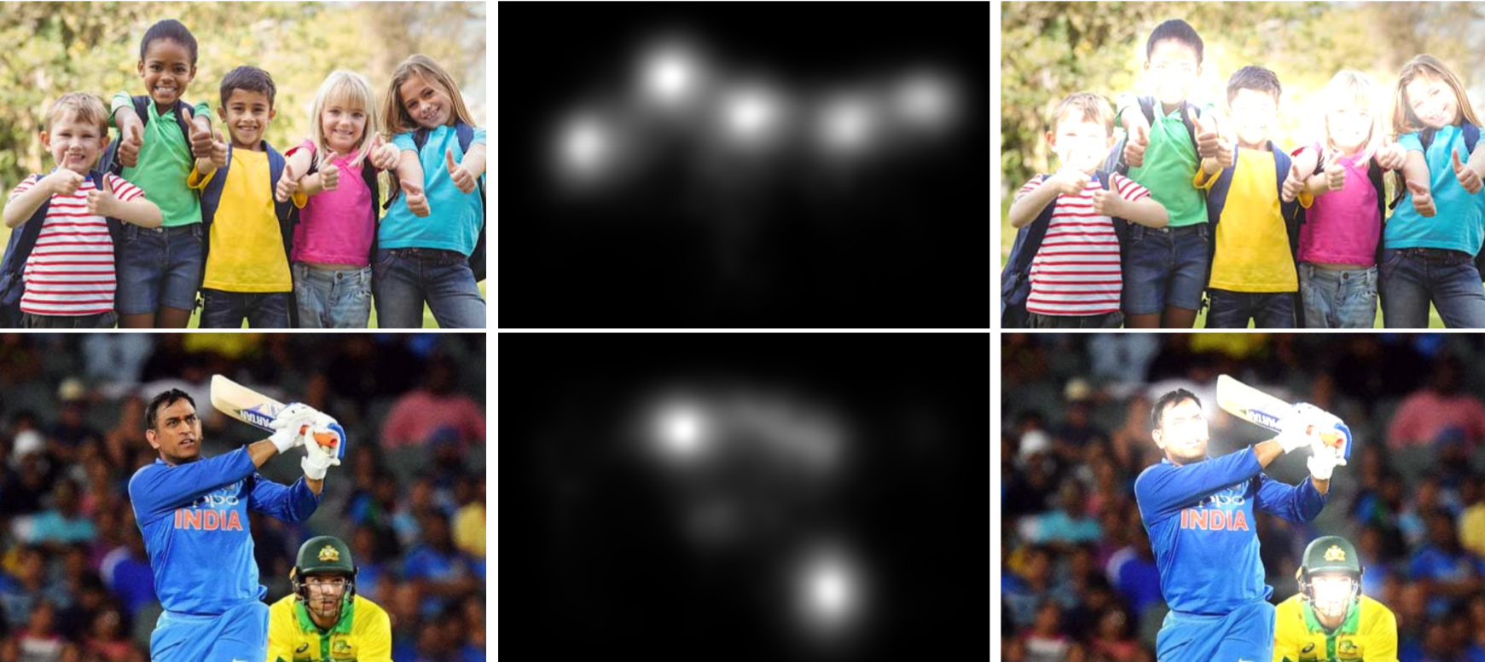
Input Image (b) Predicted Saliency Map (c) Output Image

Slide 4
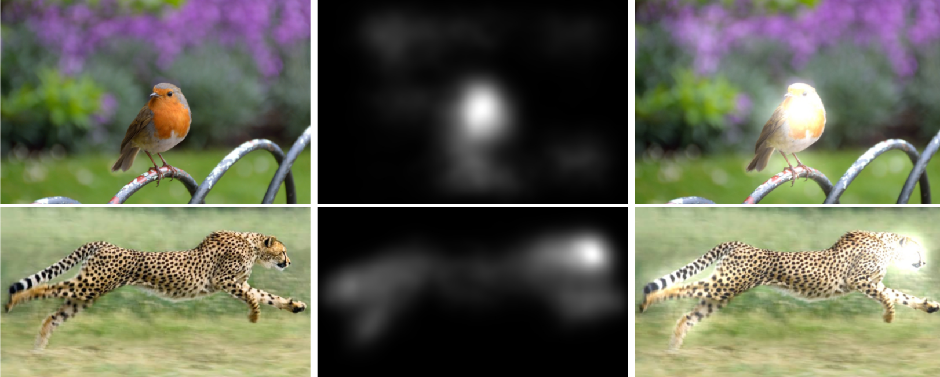
Input Image (b) Predicted Saliency Map (c) Output Image

Slide 5
Brief Literature review
Work by Itti el al. [1] was inspired more by biological than mathematical principles, there work captured center - surround differences at multiple spatial scales to three basic feature channels: color, intensity, and orientation. Their model successfully captured semantic image content, such as faces and texts.
The notion of central saliency map was introduced by Koch and Ullman [2] that combined low-level information for eye movements.

Slide 6
Dataset
SALICON Saliency Prediction Challenge (LSUN’17) dataset.
10,000 training and 5,000 validation instances.
Rescaled and padded all images from the SALICON dataset to 240 * 320 pixels.

Slide 7
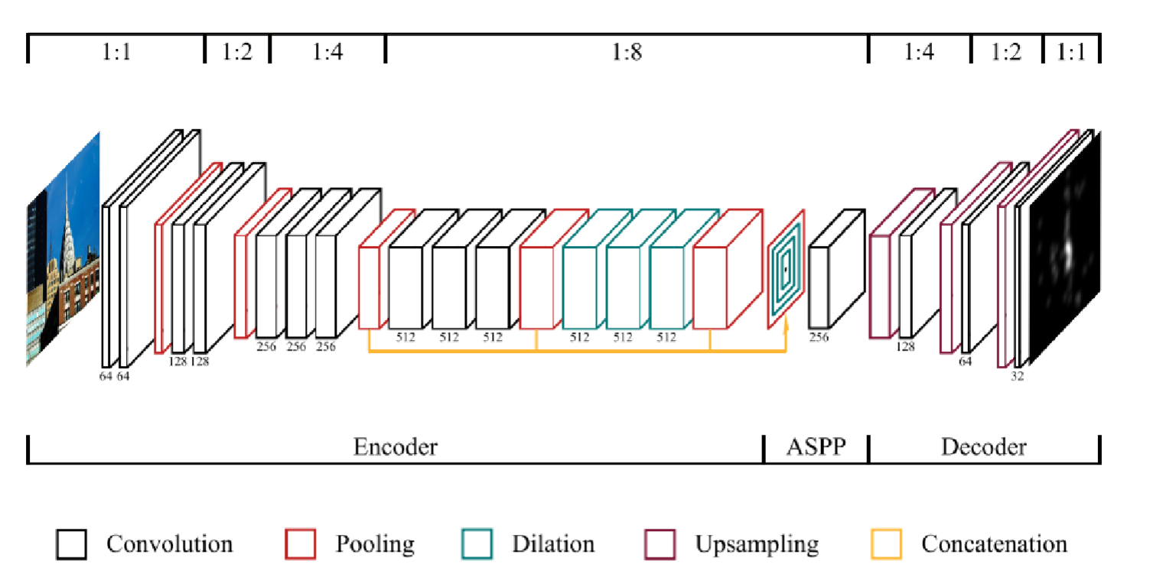
Architecture [3]

Slide 8
Architecture [3]
Spatial Features needs to be preserved when image-to-image learning problems are being considered.
Encoder of the model consists of a pretrained VGG16 architecture with 13 convolutional layers.
All dense layers are discarded and the last 3 layers are dilated at a rate of 2 to account for the omitted downsampling. The activations from 3 layers are combined.
The ASPP [4] samples information at multiple spatial scales in parallel via convolutional layers with different dilation factors.
The decoder applies a series of 3 upsampling blocks that each performs bilinear upsampling followed by a 3x3 convolution to avoid checkerboard artifacts in the image space.
Unlike all other layers, the output of the model is not modiﬁed by a ReLU.

Slide 9
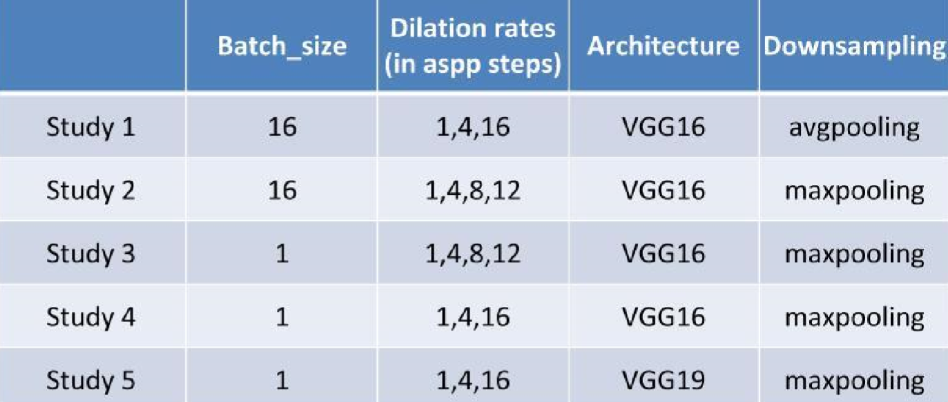
Details of the 5 studies/experiments that we performed. We train the model on RTX 2080 (8 GB GPU). VGG16 model of batch size 16 runs in approx. 1hr and VGG16 model of batchsize 1 runs in approx. 1hr 40 mins. *On GTX 1050 (2GB GPU) VGG16 batchsize 1 model shows expected training time of approx 20 hrs.

Slide 10
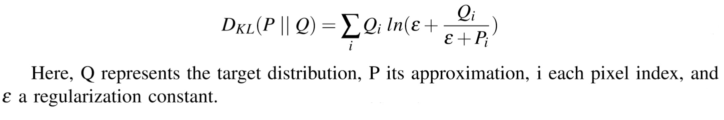
Training
Weight values from the ASPP module and decoder were initialized according to the Xavier method by Glorot and Bengio [4].
Loss function : Kullback-Leibler (KL) divergence
Optimization : Adam optimization algorithm
We modiﬁed the weights in an online fashion due to a general inefﬁciency of batch training according to Wilson and Martinez [5]
All other details of Training can be found at : http://arxiv.org/abs/1902.06634.

Slide 11
Experiments
and
Results

Slide 12
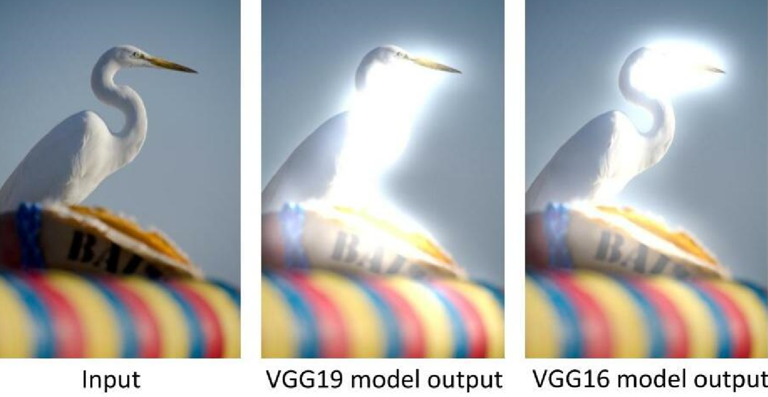
VGG19 vs VGG16

Slide 13
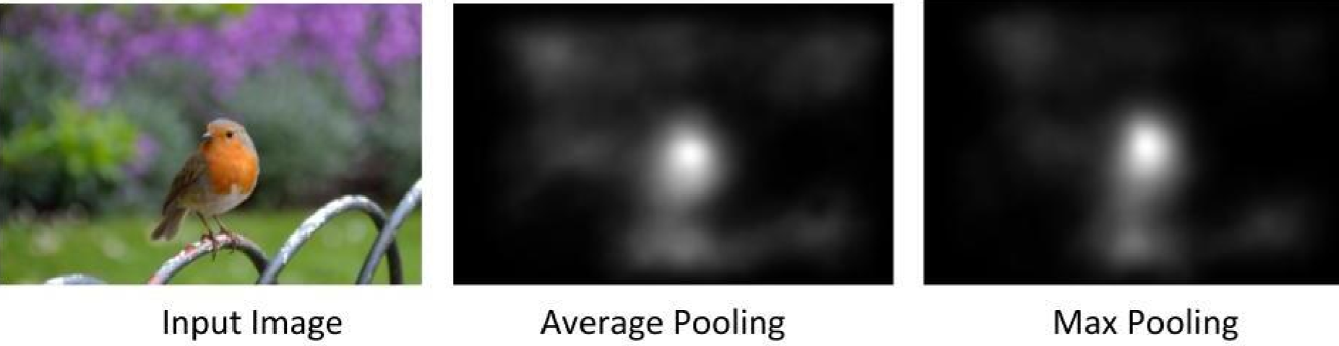
Max vs Average Pooling -> VGG16

Slide 14
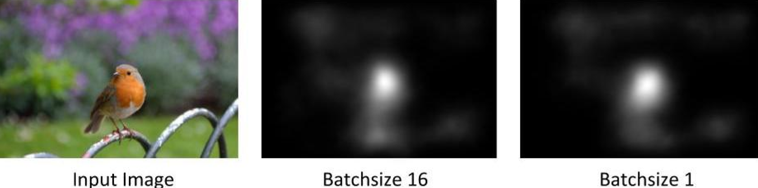
Batch_Size -> VGG16

Slide 15
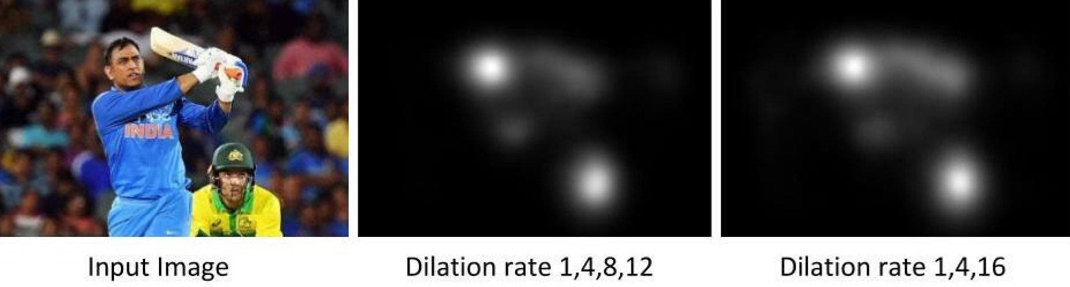
Dilation Rates -> VGG16

Slide 16
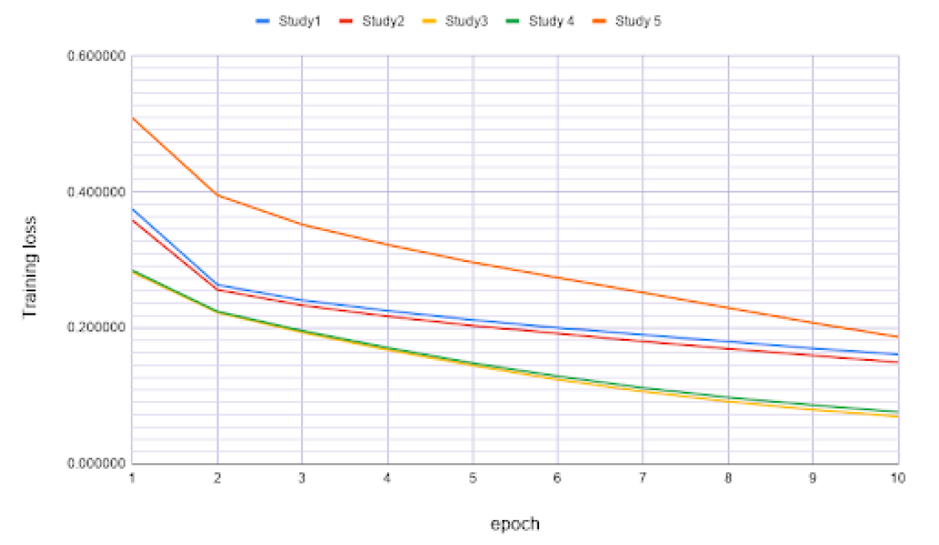

Slide 17
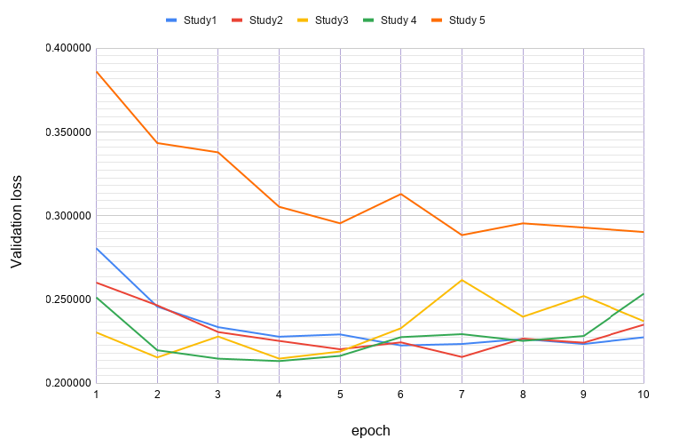

Slide 18
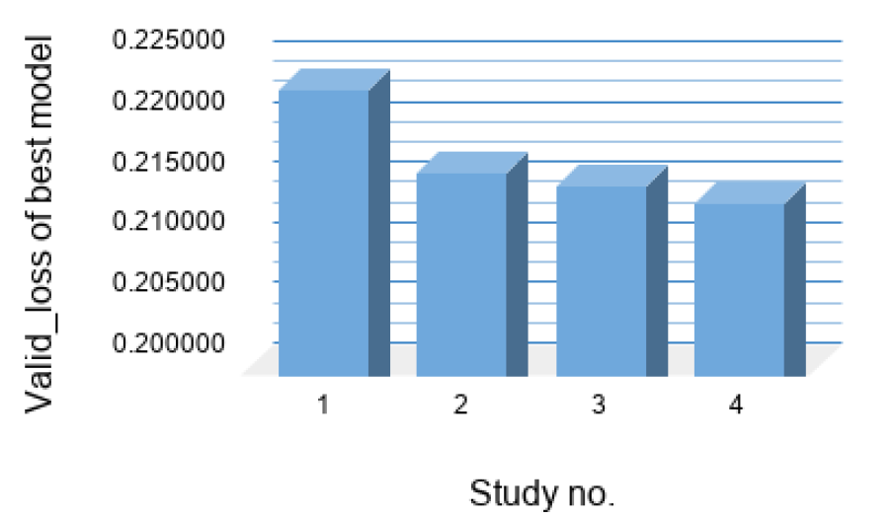

Slide 19



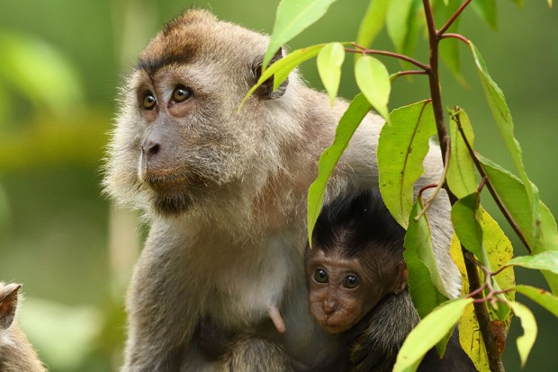

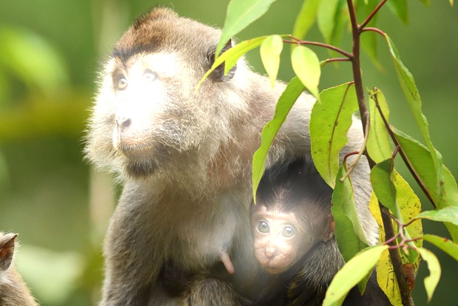
Performance of best model
Input Saliency map Output

Slide 20






Performance of best model
Input Saliency map Output

Slide 21
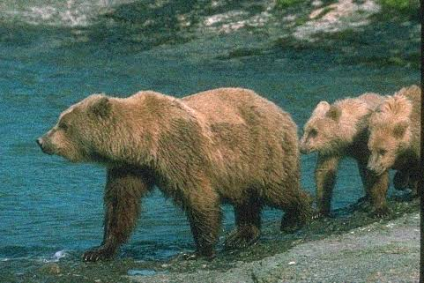
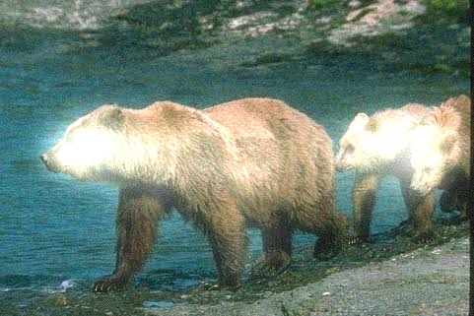
Performance of best model on noisy image
Input Output

Slide 22
Future Plans
We will look forward to implement the model to the Computer Vision applications like scene labeling and categorization and designing logos, pop-ups and stand-outs.
We want to explore salient object detection over depth and light ﬁeld images. One reason behind this is the limited availability of benchmark datasets on these problems.
We will try to look the better way to deﬁne center bias for the model to reduce the gap between prediction and ground truth.
We will like to implement similar model for instance-level saliency detection, which can be helpful in auto image editing applications.

Slide 23
Conclusion
Model includes both low-level features (ﬁrst two blocks convolutional layers) and high-level features (last three blocks convolutional layers), hence provides competitive results.
CNN based model overcomes the limitations of traditional feature detection models, such as insufﬁcient learning and poor robustness.
Performance of the model is determined by the parallel extraction of multiple features which is operated by ASPP.

Slide 24
References
[1] : Laurent Itti, Christof Koch, and Ernst Niebur. A model of saliency-based visual attention for rapid scene analysis. IEEE Transactions on Pattern Analysis & Machine Intelligence, (11):1254–1259, 1998.
[2] : Christof Koch and Shimon Ullman. Shifts in Selective Visual Attention: Towards the Underlying Neural Circuitry, pages 115–141. Springer Netherlands, Dordrecht, 1987. ISBN 978-94-009-3833-5. doi: 10.1007/978-94-009-3833-5_5.
[3] : Alexander Kroner, Mario Senden, Kurt Driessens, and Rainer Goebel. Contextual encoder-decoder network for visual saliency prediction. CoRR, abs/1902.06634, 2019.
[4] : Xavier Glorot and Yoshua Bengio. Understanding the difﬁculty of training deep feedforward neural networks. In Proceedings of the thirteenth international conference on artiﬁcial intelligence and statistics, pages 249–256, 2010.
[5] : D Randall Wilson and Tony R Martinez. The general inefﬁciency of batch training for gradient descent learning. Neural networks, 16(10):1429–1451, 2003.

Slide 25
Acknowledgement
A special thanks to Dr. Ram Subramanian for guiding us during the project
A special gratitude to IPSA lab IIT Ropar and Dr. Puneet Goyal to provide as a fast GPU
system to help us performing different experiments.

Slide 26


